Slide 1





GLOBAL PLASTIC POLLUTION ANALYSIS
Team Members:
HARISH K M [ 1VE20CS047 ]
C N DILIP KRISHNA [ 1VE20CS026 ]
ADARSH M [ 1VE20CS003 ]
APPU ANNAVEERAPPA [ 1VE20CS019 ]
BHAGYALAXMI SHEELVANT [ 1VE20CS022 ] Guide: SHILPA HARIRAJ
Disclaimer: The content is curated for educational purposes only.

Slide 2
Global Plastic Pollution
OUTLINE
Abstract
Problem Statement
Aims, Objective & Proposed System/Solution
System Design/Architecture
System Development Approach (Technology Used)
Algorithm & Deployment
Conclusion
Future Scope
References
Video of the Project
Notes:
These are the list of chapters that we are going to cover in these foundation codes. Those are chapter one what are AI and ML? chapter 2 applied Python programming in AI, and chapter 3 is exploratory data analysis for ML.

Slide 3
Abstract
Global Plastic Pollution
This abstract summarizes a global analysis of plastic pollution. Assessing the pervasive issue, the study explores the environmental impact, socioeconomic consequences, and mitigation strategies. Utilizing comprehensive data sets, the research identifies key contributors to plastic pollution, highlighting geographical hotspots and the ecological ramifications. Additionally, it examines emerging technologies and policy interventions aimed at curbing plastic waste. The findings provide valuable insights for policymakers, environmentalists, and industries to collaboratively address this urgent global challenge, fostering sustainable practices and promoting a circular economy to mitigate the detrimental effects of plastic pollution on ecosystems and human well-being.

Slide 4
Problem Statement Rapidly increasing production and inadequate waste management have led to the pervasive presence of plastic waste, adversely impacting ecosystems, wildlife, and human well-being. 1. Identifying Critical Gaps in Knowledge 2. Understanding Sources and Distribution 3. Assessing Ecological Consequences 4. Developing Effective Strategies 5. Implementing Sustainable Policies
Global Plastic Pollution

Slide 5
Aim and Objective Aim:
The overarching aim of the global plastic pollution analysis is to comprehensively investigate and understand the intricate dynamics of plastic pollution on a worldwide scale. The study seeks to identify, analyze, and address the root causes, sources, and consequences of plastic pollution, with the ultimate goal of contributing to the development of effective strategies Objectives:
1.Source Identification 2.Distribution Patterns 3.Ecological Consequences 4.Socio-economic Assessment
Global Plastic Pollution
for global mitigations.

Slide 6
Proposed Solution
Global Plastic Pollution
Source Reduction Initiatives: Implement regulations and incentives to reduce the production and consumption of single-use plastics. Encourage businesses to adopt sustainable packaging practices.
Public Awareness and Education:
Launch awareness campaigns to educate the public about the environmental impact of plastic pollution.
Promote responsible consumer behavior through educational programs.
Waste Management Enhancement:
Invest in improved waste collection and recycling infrastructure globally.
Implement community-based initiatives for responsible waste disposal.

Slide 7
System Architecture
Global Plastic Pollution
To conduct a global plastic pollution analysis using Jupyter for data analysis, you would typically follow a system architecture that involves several components. Here is a high-level overview:
Data Collection
Data Pre-processing
Exploratory Data Analysis (EDA)
Statistical Analysis

Slide 8
System Deployment Approach
Global Plastic Pollution
Data Sharing Platform:
Create a centralized platform for sharing data, research findings, and success stories to facilitate global collaboration and learning.
Needs Assessment:
Conduct a thorough analysis of the global plastic pollution scenario, identifying key areas and aspects that require urgent attention.
Assessment and Planning:
Conduct a thorough analysis of current plastic pollution levels and hotspots globally.
Develop a detailed plan outlining goals, key milestones, and resource requirements.

Slide 9
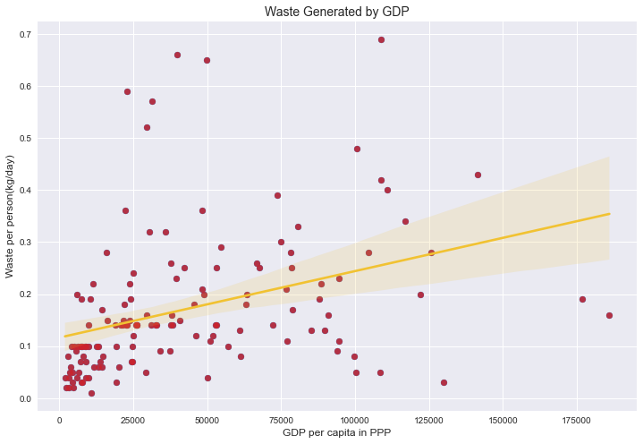
Algorithm & Deployment
Global Plastic Pollution
Data Collection
Data Pre-processing
Exploratory Data Analysis (EDA)
Spatial Analysis
Machine Learning
Statistical Analysis

Slide 10
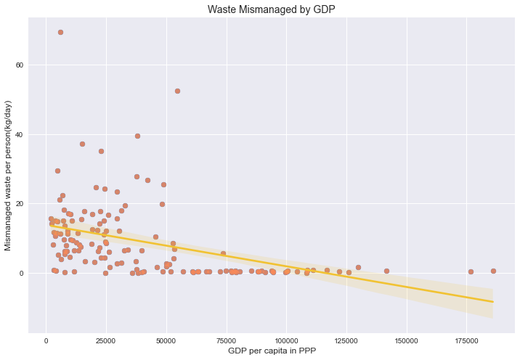
Conclusion
Global Plastic Pollution
Based on the graphs, higher GDP per capita is associated with less mismanaged waste and more generated waste. Developed countries produce more waste but are better at managing it. Emerging economies engaged in plastic waste trading must prevent waste from polluting oceans.
To tackle plastic pollution, a multi-pronged approach is needed:
1. Encourage eco-friendly plastics.
2. Limit single-use plastics.
3. Repurpose plastic waste ethically and responsibly.

Slide 11
Future Scope
Global Plastic Pollution
Technological Advancements
Monitoring and Surveillance Systems
Machine Learning and AI Applications
Innovative Clean-up Technologies

Slide 12
Global Plastic Pollution
Reference
Datasets : Kaggle
https://www.kaggle.com/datasets/sohamgade/plastic-datasets
Notes:
Reference
These are the references for this session.
12

Slide 13
Global Plastic Pollution
Thank you!
Notes:
thank you very much for joining this PPT, keep learning.
13

